Slide 1



Department of Computer Science
University Institute of Engineering
DEPARTMENT OF COMPUTER SCIENCE & ENGINEERING
Bachelor of Engineering
Subject Name: System Programming
Subject Code: CST-281
Compilers
DISCOVER . LEARN . EMPOWER

Slide 2
Chapter-1.2 Macro
Department of computer Science
Nested Macro Calls
Advanced Macro Facilities
Design Of a Macro Preprocessor

Slide 3
Nested Macro Calls
Nested Macro Definitions
A macro body may also contain further macro definitions. However, these nested macro definitions aren't valid until the enclosing macro has
been expanded! That means, the enclosing macro must have been called, before the nested macros can be called.
OR
Nested macros are macros in which definition of one macro contains definition of other macros.Consider the macro definition example given below, which is used to swap two numbers. The macro named SWAP defines another macro named STORE inside it. These type of macro are called nested macros.
SWAP MACRO &X,&Y
LDA &X
LDX &Y
STORE MACRO &X,&Y
STA &Y
STX &X
MEND MEND
Inner macro
outer macro

Slide 4
Flow of control during Macro expansion
The default flow of control during Macro expansion is sequential.
The preprocessor statement can alter the flow of control like conditional expansion.
Same ststements visited during flow of control are called Loop Expansions.

Slide 5
Macro expansion
Macro expansion is implemented using a macro expansion counter (MEC).
Algorithm: (Outline of macro expansion)
MEC=statement number of first statement following the prototype statement;
While statement pointed by MEC is not a MEND statement
(a) if a model statement then
Expand the statement
(ii) MEC=MEC+1;
(b) Else (i.e. a preprocessor statement)
(i) MEC= new value specified in the statement;
Exit from macro expansion.

Slide 6
Advanced MACRO Facilities
It is having facilities for change of flow of control.
Expansion Time Variables
Attributes of parameters
Advanced Directives
- Remove Directives
-IRP Directive
-The Repeat Directive

Slide 7
Advanced Macro Facilities
Two features are provided for this purpose
Alteration of flow of control during expansion:
Expansion time sequencing symbols (SS) Sequencing symbol has syntax .
.<ordinary string>
A SS is defined by putting it in the label field of statement in the macro body.
2. Expansion time statements AIF, AGO and ANOP for expansion control transfer.
An AIF statement has syntax
AIF (<expression>) <sequencing symbol>
Where relational expression involving ordinary strings, formal parameters and their
attributes, and expansion time variables.
If the relational expression evaluates to true, expansion time control is transferred to the statement containing
<sequencing symbol> in its label field.

Slide 8
AGO/ANOP
An AGO statement has the syntax
AGO <sequencing symbol>
Unconditionally transfer expansion time control to the statement containing <sequencing symbol> in its label field.
An ANOP statement is written as
<sequencing symbol>ANOP
Simply has the effect of defining the sequencing symbol.

Slide 9
Expansion Time Variable
Expansion time variable are variables which can only be used during the expansion of macro calls.
Local EV is created for use only during a particular macro call. 
Global EV exists across all macro calls situated in program and can be used in any macro which has a declaration for it.
LCL<EV Specification>[,<EV specification>…]
GBL <EV specification>[,<EV specification>…]
<EV specification>has syntax
<EV Name> where EV name is ordinary string.
Initialize EV by preprocessor statement SET.
<EV Specification >SET<SET-Expression>

Slide 10
Example
MACRO
TEST &X, &Y, &Z
AIF (&Y EQ &X) .ONLY
MOVER AREG, &Y
AGO .LAST
.ONLY MOVER AREG, &Z
.LAST MEND
REPRESENTING S...Expansion time variables
EV’s are variables which can be only used during the expansion
of macro calls.

Slide 11
Advanced Macro Facility- Attributes of parameters
An attribute is written using the syntax:-
<attribute name> ’ <formal parameter specification>
T–Type
L-Length
S-Size
EXAMPLE
MACRO
ME &A
AIF (L’& A EQ 1).NEXT
_____
_______

Slide 12
Advance directives
• The Remove Directive: Remove Macro from MDT(Macro definition table).
• The IRP Directive: (Indefinite repeat)
It is used by the assembler to repeatedly duplicate and assemble the sequence a number of times determined by a compound parameter.
IRP Example
MACRO
MAX_X &P,&Q
IRP &P
ADD REG1,&P
IRP
MEND
MACRO CALL :- MAX_X(A,B,#3),H
on Execution
ADD REG1,A
ADD REG1,B
ADD REG1,#3

Slide 13
The REPEAT (REPT)Directive
REPEAT: ): This is another facility with assembler to duplicate and
assemble the sequence a number of times during Macro Expansion.
Syntax: REPT <Expression>
MACRO
DEF_R
LCL &P
&P SET 5
REPT 5
DC ‘&P’
& P SET &P+1
ENDM
MEND
Output 5,6,7,8,9,10

Slide 14
Design of a Macro Processor
Two pass Macro Processor
General Design Steps
Step 1: Specification of Problem:-
Step 2 Specification of databases
Step3: Specification of Database formats
Step 4: Algorithm

Slide 15
Two pass Macro Processor
All macro definitions are processed during the first pass and all macro invocation statements are expanded during second pass.
Such a two pass macro processor cannot handle nested macro definitions.
•Consider the macro definition example given below, which is used to swap two numbers. The macro named SWAP defines another macro named STORE inside it. These type of macro are called nested macros.

Slide 16
Two pass Macro Processor
SWAP MACRO &X,&Y
LDA &X
LDX &Y
STORE MACRO &X,&Y
STA &Y
STX &X MEND MEND
It contains Inner Macro STORE and Outer Macro SWAP.
outer macro

Slide 17
One pass macro processor
A one-pass macro processor uses only one pass for processing macro definitions and macro expansions.
It can handle nested macro definitions.
To implement one pass macro processor, the definition of a macro must appear in the source program before any statements that invoke that macro.

Slide 18
Data Structures involved in the design of one pass macro processor
There are 3 main data structures involved in the design of one pass macro processor:
DEFTAB
NAMTAB
ARGTAB
1.Definition table (DEFTAB)
All the macro definitions in the program are stored in DEFTAB, which includes macro prototype and macro body statements.

Slide 19
Data Structures involved in the design of one pass macro processor
Comment lines from macro definition are not entered into DEFTAB because they will not be a part of macro expansion.
•References to the macro instruction parameters are converted to a positional notation for efficiency in substituting arguments.
Name table (NAMTAB)
•The macro names are entered into NAMTAB
•NAMTAB contains pointers to beginning and end of definition in DEFTAB.
Argument table (ARGTAB)
•The third data structure is an argument table (ARGTAB), which is used during expansion of macro invocations.

Slide 20
Data Structures involved in the design of one pass macro processor
When macro invocation statements are recognized, the arguments are stored in ARGTAB according to their position in argument list.
As the macro is expanded, arguments from ARGTAB are substituted for the corresponding parameters in the macro body.

Slide 21
Example: Consider the following source code
SUM MACRO &X,&Y
LDA &X
MOV B
LDA &Y
ADD B MEND START
LDA 4500
ADD B
SUM P,Q
LDA 3000
…………. END

Slide 22
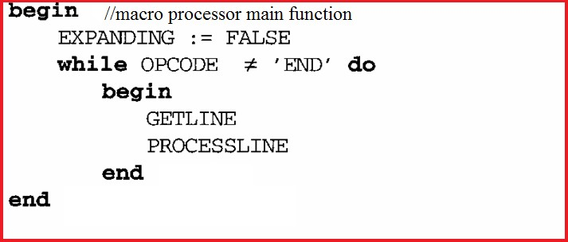
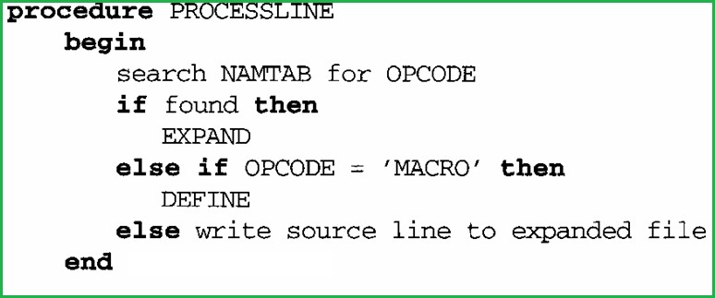
Algorithm for one pass macro processor

Slide 23
Explanation of algorithm
The algorithm uses 5 procedures
MACROPROCESSOR (main function)
DEFINE
EXPAND
PROCESSLINE
GETLINE

Slide 24
MACROPROCESSOR (MAIN function)
•This function initialize the variable named EXPANDING to false.
•It then calls GETLINE procedure to get next line from the source program and PROCESSLINE procedure to process that line.
PROCESSLINE
•This procedure checks
oIf the opcode of current statement is present in NAMTAB. If so it is a macro invocation statement and calls the procedure EXPAND

Slide 25
DEFINE
•The control will reach in this procedure if and only if it is identified as a macro definition statement.Then:
oMacro name is entered into NAMTAB
oThen the macro name along with its parameters are entered into DEFTAB.
EXPAND
•The control will reach in this procedure if and only if it is identified as a macro call.
•In this procedure, the variable EXPANDING is set to true. It actually indicates the GETLINE procedure that it is going to expand the macro call. So that GETLINE procedure will read the next line from DEFTAB instead of reading from input file.

Slide 26
GETLINE
•This procedure is used to get the next line.
•If EXPANDING = TRUE, the next line is fetched from DEFTAB. (It means we are expanding the macro call)
•If EXPANDING = False, the next line is read from input file.

Slide 27
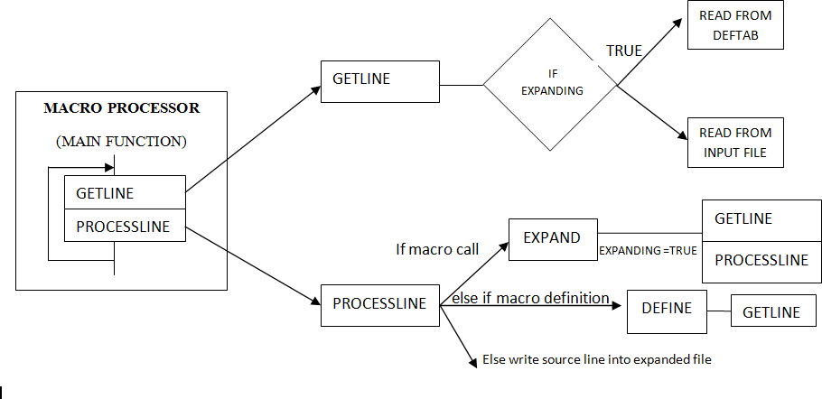
Flow Diagram of a one pass macroprocessor

Slide 28
References
John J Donovan Systems Programming Ebook Wordpress (pdflife.one)
[PDF] Systems Programming and Operating Systems by Dhamdhere - Free Download PDF (dlscrib.com)

Slide 29

THANK YOU

